Slide 1
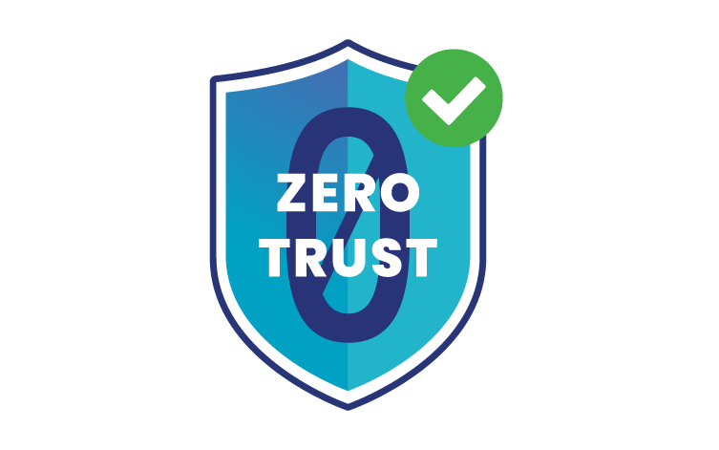
Presented By
T.Aravinthasamy
Computer Science And Engineering
The Kavery Engineering College

Slide 2
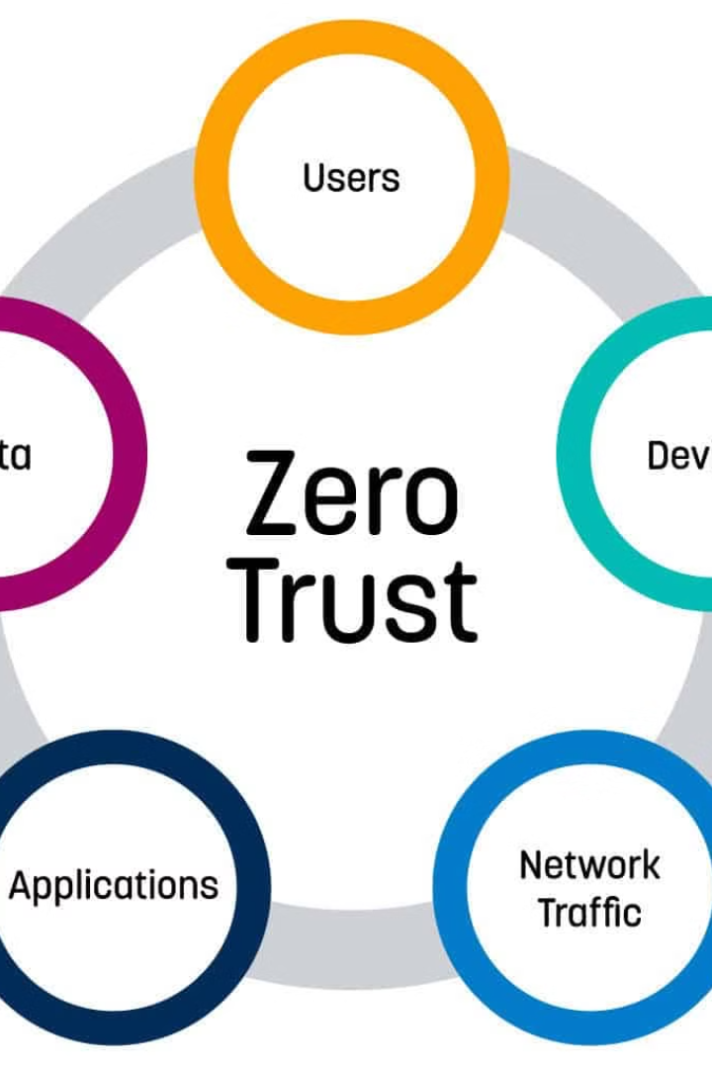
Zero Trust Security
Zero trust is a cybersecurity model that requires constant verification and continuous monitoring, rather than relying on traditional perimeter-based security approaches. It's an essential strategy for protecting modern, distributed digital environments.

Slide 3

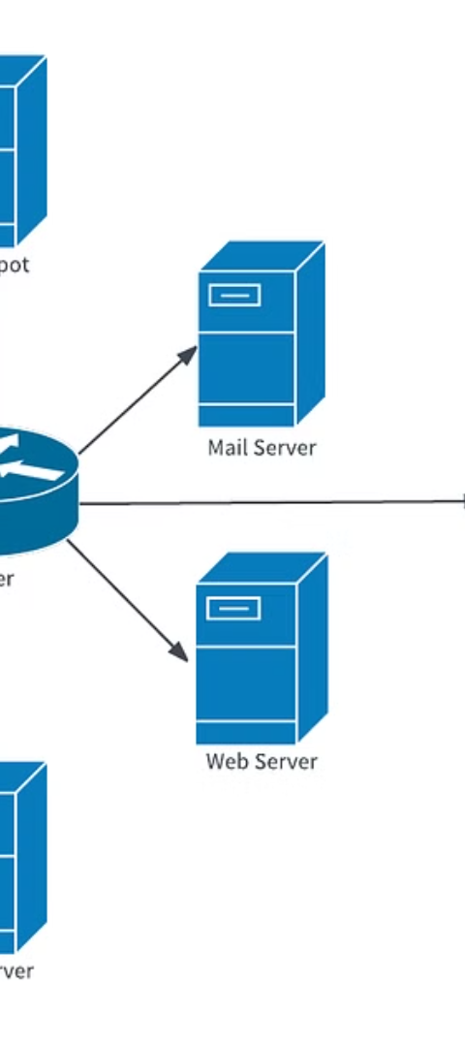
The Problem with Traditional Security
1
Outdated Perimeter-Based Approach
2
Increased Attack Surface
The proliferation of devices, users, and applications has expanded the attack surface, making it difficult to enforce consistent security policies.
Relying on firewalls and VPNs to create a "trusted" internal network is no longer effective in today's cloud-based, mobile-first world.
3
Lack of Visibility
Traditional security models struggle to provide visibility and control over distributed resources, leaving blind spots for potential threats.

Slide 4
Principles of Zero Trust Security
Verify Explicitly
Least Privilege Access
Assume Breach
Authenticate and authorize users and devices based on all available data points, not just network location.
Grant the minimum level of access required for a user or device to perform their tasks, continuously evaluating and adjusting permissions.
Continuously monitor and protect data and resources, even within the "trusted" internal network, to detect and respond to threats.

Slide 5
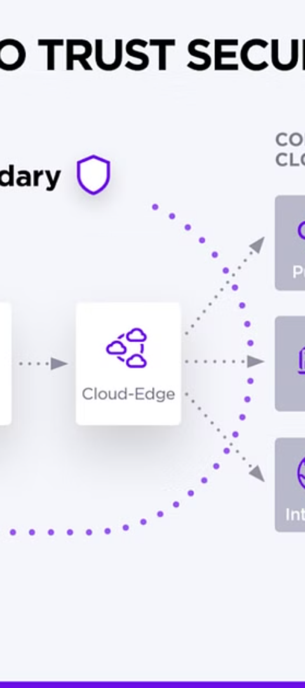
Implementing Zero Trust
1
Identify Assets
Catalog and classify all users, devices, applications, and data to understand the attack surface.
2
Establish Trust Policies
Define and enforce granular access controls based on user, device, and context-based factors.
3
Implement Continuous Monitoring
Continuously assess risk and adapt access policies to detect and respond to threats in real-time.

Slide 6
Zero Trust Architecture
Identity and Access Management
Threat Protection
Verify user and device identities, and grant the least-privileged access required.
Detect and respond to threats by continuously monitoring user and entity behavior.
Data Protection
Orchestration and Automation
Classify and protect sensitive data, ensuring it is only accessed by authorized entities.
Automate security policies and response workflows to enhance visibility and control.

Slide 7




Benefits of Zero Trust
Improved Security
Operational Efficiency
Compliance
Improved User Experience
Reduces attack surface and mitigates the impact of breaches by continuously verifying access.
Helps organizations meet regulatory requirements by enforcing granular access controls.
Automates security processes and adapts policies to changing conditions, enhancing productivity.
Provides a seamless and secure access experience for users, regardless of location or device.

Slide 8




Transitioning to Zero Trust
Assessment
Planning
Implementation
Continuous Improvement
Evaluate the current security posture and identify gaps to address.
Develop a comprehensive strategy and roadmap for adopting zero trust principles.
Incrementally deploy zero trust controls and technologies across the organization.
Monitor, refine, and adapt the zero trust framework to address evolving threats and needs.

Slide 9
Future of Zero Trust
Advancements in AI and Machine Learning
Enhance threat detection and adaptive access controls
Emerging IoT and Edge Computing
Extend zero trust principles to distributed devices and environments
Quantum-Resistant Cryptography
Ensure the long-term security of sensitive data and communications
Decentralized Identity Management
Enable user-centric authentication and authorization models

Slide 10

Conclusion
Zero trust security is a fundamental shift in how organizations approach cybersecurity, focusing on continuous verification, least-privilege access, and a holistic, data-centric approach to protection. As the threat landscape evolves, embracing zero trust principles will be crucial for safeguarding modern, distributed digital environments.

